Slide 1

Cataract detection and grading
Guide: Dr. Sagarika Bora

Slide 2
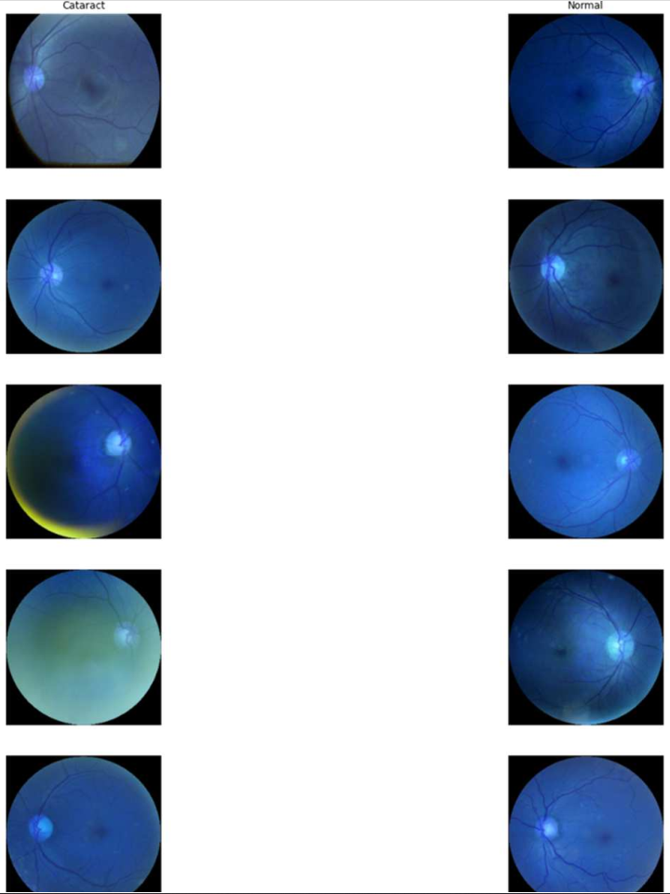
Abstract
Cataract is one of the most prevalent causes of blindness in the modern society, accounting for 50% of blindness. According to a survey done by WHO/NPCB there is a backlog of over 22 million blind eyes (12 million blind people) in India. 80.1% of these are blind due to cataract. The annual incidence of cataract blindness is about 3.8 million. Early detection and treatment can reduce the suffering and prevent visual impairment from turning into blindness. But the expertise needed for early detection and grading is down to availability of expert trained eye specialist which may not be available in rural parts of the country. Existing studies on automatic detection and grading based on fundus images utilizes a predefined set of images provide an incomplete, redundant or noisy representation. In this project, the aim is to use Deep Convolutional Neural Network (DCNN) to detect and grade cataract automatically. This will help in early detection of cataract even without the presence of an trained eye specialist in some of the remote parts of the country.

Slide 3
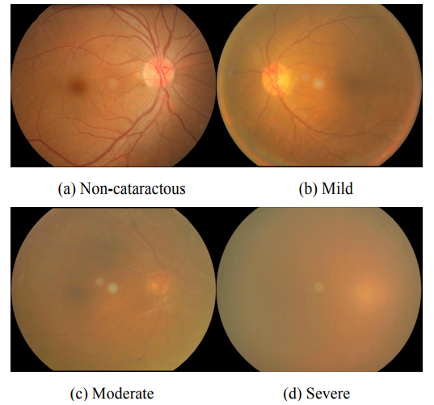
OBJECTIVE: Cataract Detection and Grading using Deep Convolutional Neural Network.
RATIONALE: The Rationale to opt for this Topic:
-> Early Detection and treatment for Cataract.
-> Prevention from permanent blindness.
PROBLEM STATEMENT:
Cataract is the lead cause of blindness in the country and worldwide accounting for 80.1% in India and 50% around the world. Lack of trained expert in remote locations makes it difficult to detect and treat cataract, using DCNN to create an automated detection and grading model would help in reducing the chances of blindness to people even in the most remote parts of the world/country where presence of trained expert is not possible.

Slide 4
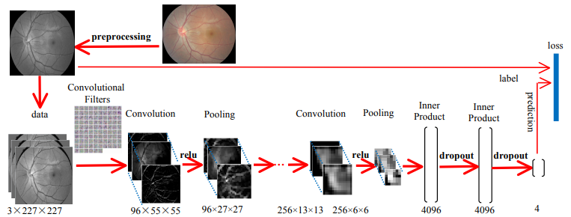
Architectural design of the proposed system

Slide 5
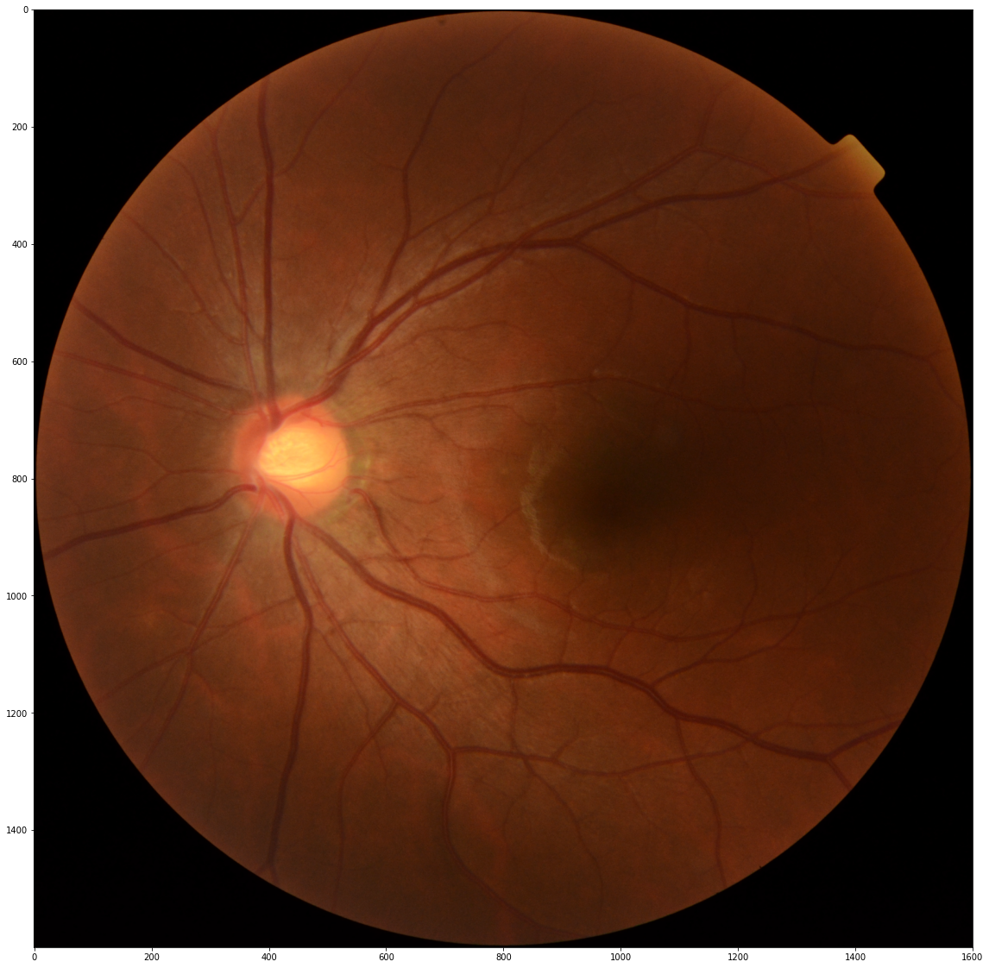
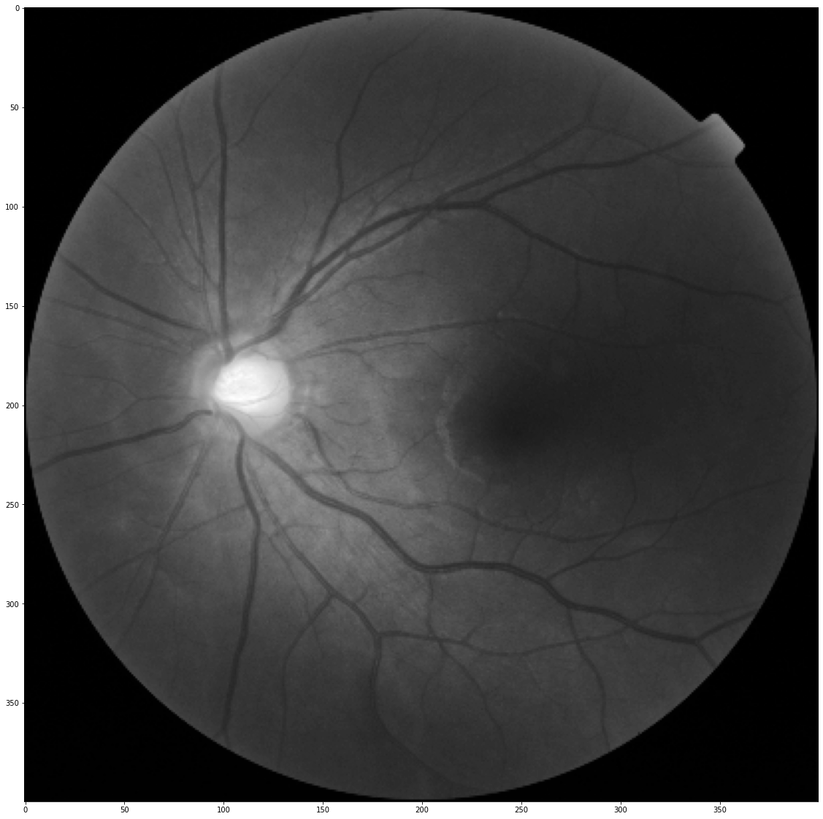
Algorithms and techniques
PREPROCESSING: Image Preprocessing is the first step taken, Images are reshaped and converted to G-Channel.
DEEP NEURAL NETWORK: For our problem we will deploy DCNN with eight layers, the first five will be convolutional layers and the remaining three layers will be fully connected layers. The output of the last fully connected layer will be fed to a four-way SoftMax which produces a distribution over the four class labels.

Slide 6
Expected outcome
Deep Convolutional Neural Network (DCNN) is capable of achieving top notch results in challenging cataract detection and grading tasks using purely supervised learning. The expectations from this method is to get record breaking Accuracy and time efficiency. Through DCNN, discriminative features that characterize high level information are extracted effectively and automatically, rather than artificially. Furthermore, the feature extraction and classifier combined demonstrates a higher level of intelligence. This approach has been confirmed to great practical significance in early cataract screening and diagnosis and has great scope of being applied in other eye related diseases.

Slide 7
References
1. Linglin Zhang et al., "Automatic cataract detection and grading using Deep Convolutional Neural Network," 2017 IEEE 14th International Conference on Networking, Sensing and Control (ICNSC), 2017.
2. Y. Dong, Q. Zhang, Z. Qiao and J. Yang, "Classification of cataract fundus image based on deep learning," 2017 IEEE International Conference on Imaging Systems and Techniques (IST), 2017, pp. 1-5, doi: 10.1109/IST.2017.8261463.
3. X. Gao, S. Lin and T. Y. Wong, "Automatic Feature Learning to Grade Nuclear Cataracts Based on Deep Learning," in IEEE Transactions on Biomedical Engineering, vol. 62, no. 11, pp. 2693-2701, Nov. 2015, doi: 10.1109/TBME.2015.2444389.
4. M. S. Mahmud Khan, M. Ahmed, R. Z. Rasel and M. Monirujjaman Khan, "Cataract Detection Using Convolutional Neural Network with VGG-19 Model," 2021 IEEE World AI IoT Congress (AIIoT), 2021, pp. 0209-0212, doi: 10.1109/AIIoT52608.2021.9454244.
5. M. S. Junayed, M. B. Islam, A. Sadeghzadeh and S. Rahman, "CataractNet: An Automated Cataract Detection System Using Deep Learning for Fundus Images," in IEEE Access, vol. 9, pp. 128799-128808, 2021, doi: 10.1109/ACCESS.2021.3112938.
6. Goh, Jocelyn Hui Lin; Lim, Zhi Wei BSc (Hons); Fang, Xiaoling MD; Anees, Ayesha MSc; Nusinovici, Simon PhD∗; Rim, Tyler Hyungtaek MD, PhD; Cheng, Ching-Yu MD, PhD; Tham, Yih-Chung PhD, Artificial Intelligence for Cataract Detection and Management, Asia-Pacific Journal of Ophthalmology: March-April 2020 - Volume 9 - Issue 2 - p 88-95 doi: 10.1097/01.APO.0000656988.16221.04.

